Slide 1

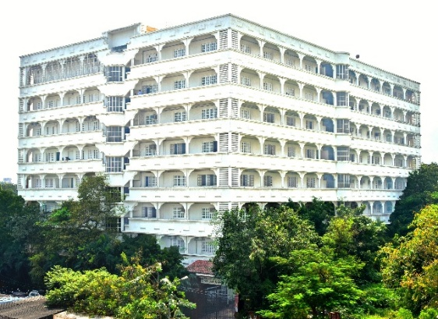
Mahavir Education Trust’s
Shah & Anchor Kutchhi Engineering College
Chembur, Mumbai-400088
(An Autonomous Institute Affiliated to University of Mumbai)
Department of
Electronics (VLSI Design and Technology)
presentation
on
REAL-TIME BODY TEMPERATURE MONITORING PROTOTYPE
(Subject: Microproject, Embedded System Design, V semester)
by
BHUMI LADE- 124BTVL1022
SUMEDHA GAJBHIYE- 124BTVL1037
Guided By
Ms. Vidya Gogate, Mr. Yogesh Kene

Slide 2


OUTLINE
Problem Definition
Objectives
Course Outcome
SDG Mapping
Selection of hardware components
System Architecture HW and SW
RESULT
Design Metrics Considered

Slide 3
PROBLEM DEFINITION
Conventional body temperature measurement often requires physical contact and manual observation, which may be inconvenient for continuous or repeated monitoring.
The proposed system provides a contactless, real-time temperature monitoring prototype capable of:
Measuring body temperature without physical contact.
Continuously displaying temperature readings.
Automatically detecting temperatures above a predefined threshold.
Providing immediate visual and audible alerts.
Offering a simple and low-cost embedded healthcare monitoring solution.

Slide 4






OBJECTIVES
Sensing
Connectivity
Intelligence
Measure body temperature using the MLX90614 infrared temperature sensor.
Perform non-contact temperature measurement in real time.
Interface MLX90614 and OLED with ESP32 using I²C communication.
Integrate LEDs and buzzer through ESP32 GPIO pins.
Process temperature readings using ESP32.
Compare measured temperature with a predefined fever threshold.
Automatically activate appropriate LED and buzzer indications.

Slide 5
Course Outcome
Design embedded systems using suitable hardware and software components for real-time applications.
Through this project:
Interfacing of sensors and output devices with ESP32 was implemented.
I²C communication was used for sensor and display interfacing.
Real-time sensor data acquisition and processing were performed.
Decision-making logic was implemented for temperature classification.
Hardware and embedded software were integrated into a working prototype.
.

Slide 6



SDG MAPPING
03
09
10
GOOD HEALTH AND WELL-BEING
Innovation
REDUCED INEQUALITIES
Supports basic health monitoring through quick and contactless temperature measurement.
Fostering technological infrastructure in rural and agricultural sectors.
Low-cost embedded healthcare devices can contribute toward making basic monitoring technologies more accessible.
Aligned with UN Sustainable Development Goals for 2030.

Slide 7
Selection of Hardware Components
ESP32 Development Board
Main controller of the system.
Processes sensor readings and controls all outputs.
Provides I²C and GPIO interfaces.
MLX90614 IR Temperature Sensor
Performs non-contact infrared temperature measurement.
Measures object/body and ambient temperature.
Communicates through I²C.
0.96" OLED Display – SSD1306
Displays body and ambient temperature.
Displays NORMAL/FEVER status.
Provides a simple graphical user interface.
Buzzer
Generates an audible warning during high-temperature detection.
Red LED
Indicates FEVER / elevated temperature condition.
White LED
Indicates NORMAL temperature condition.
Additional Components
Breadboard, jumper wires, resistors and USB/power supply.
.

Slide 8
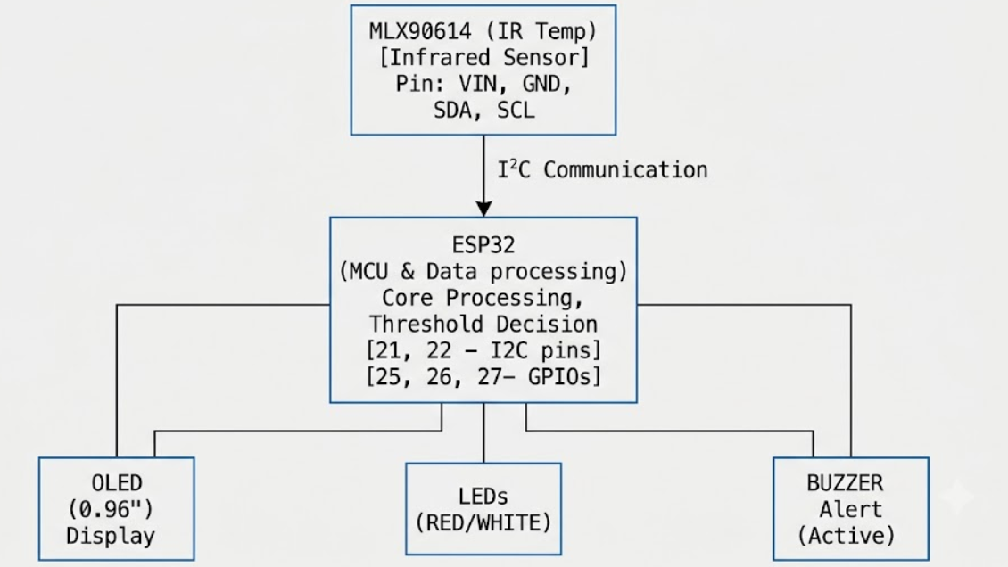
SYSTEM ARCHITECTURE
.
.

Slide 9
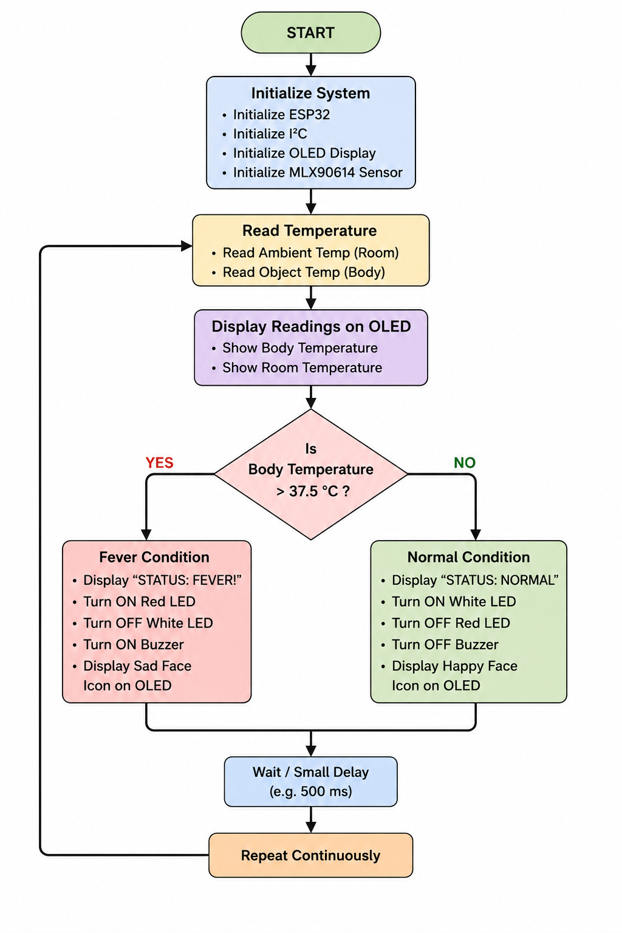


ALGORITHM
.

Slide 10
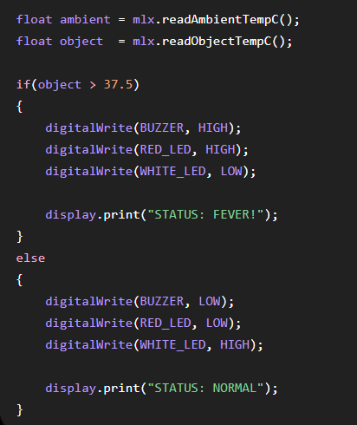
PROGRAM
This is the important logic behind the entire system:
Software Platform: Arduino IDE
Programming Language: Embedded C/C++
Communication Protocol: I²C
.

Slide 11
RESULT
NORMAL CONDITION
When the measured body temperature is below the threshold:
OLED displays real-time body and room temperature.
Status displayed as NORMAL.
White LED turns ON.
Red LED remains OFF.
Buzzer remains OFF.
Happy-face indication appears on OLED.
ELEVATED TEMPERATURE CONDITION
When temperature exceeds 37.5°C:
Status changes to FEVER!
Red LED turns ON.
White LED turns OFF.
Buzzer provides an audible alert.
Sad-face warning indication appears on OLED.
.

Slide 12
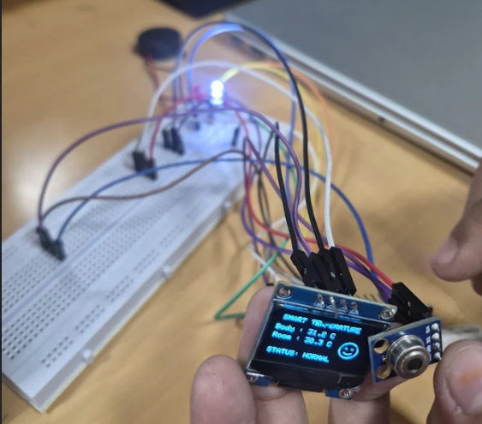
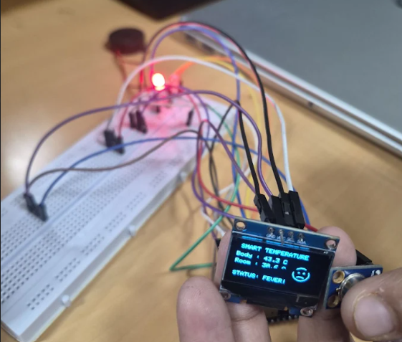
RESULT
.

Slide 13
Design Metrics Considered
Real-time response: Continuously updates temperature readings.
Non-Contact sensing: MLX()^!$ infrared sensing.
User Interface: OLED temperature and status display.
Alert Mechanism: LED and buzzer indication.
Processing: ESP32- based real-time decision making.
Communication: I2C sensor/ display interface.
Portability: Compact embedded hardware.
Cost: Uses commonly available components.
Power: Low-power electronic components.
Modularity: Individual components can be upgraded.
.

Slide 14
CONCLUSION
Successfully developed a real-time contactless body temperature monitoring prototype.
MLX90614 enables non-contact temperature sensing.
ESP32 performs continuous data acquisition and threshold-based decision making.
OLED provides real-time temperature and system status. LEDs provide immediate visual indication of normal and elevated temperature conditions.
Buzzer provides an audible warning during elevated temperature detection.
The project demonstrates successful integration of sensing, processing, display and alert mechanisms in an embedded system
.

Slide 15
FUTURE SCOPE
Add Wi-Fi/IoT connectivity for remote temperature monitoring.
Store temperature history on a cloud platform or database.
Develop a mobile application for live monitoring.
Add patient identification and multiple-user data storage.
Generate notifications for abnormal temperature readings.
Improve enclosure and sensor positioning for a more practical device.
Perform calibration and validation against appropriate reference instruments.
Extend the prototype into a multi-parameter health monitoring system.
.

Slide 16

THANK YOU
Questions? We'd love to discuss our project further.
Shah & Anchor Kutchhi Engineering College
Mumbai, India
Electronics Engineering (VLSI Design and Technology Department)

